Slide 1
IBC, Modified IBC, SBC, and Site Specific Considerations
Shahram Pezeshk, Ph.D., P.E.
spezeshk@memphis.edu

Slide 2




IBC 2018 and ASCE7-16

Slide 3
Evolution of Seismic Codes
SEAOC, 1980
San Fernando, 1971
UBC, 1982
ATC, 1978
ANSI, 1982
UBC, 1985
BSSC, 1985
SBC, 1994,1997
UBC, 1988
NEHRP, 1991
SBC, 1999
UBC, 1992
NEHRP, 1994
IBC2000
IBC03 & IBC06,
IBC2012,IBC2015,
IBC2020,
ASCE7-10, ASCE7-16
UBC, 1994
NEHRP, 97,03
UBC, 1997

Slide 4
Maximum Considered Earthquake Ground Motion
The NEHRP 94, seismic hazards around the nation were defined at a uniform 10% probability of exceedance in 50 years and the design requirements were based on assigning a structure to a Seismic Hazard Exposure Group and a Seismic Performance Category (SPC).
While this approach provided a uniform likelihood throughout the nation that the design ground motion would not be exceeded, it did not provide for a uniform margin of failure for structures designed for that ground motion.

Slide 5
Maximum Considered Earthquake Ground Motion
It is intended to provide a uniform margin against collapse at the design ground motion.
Ground motion hazards are defined in terms of maximum considered earthquake ground motions.
The maximum considered earthquake ground motions are based on a set of rules that depend on the seismicity of an individual region.

Slide 6
Calculation of Seismic Coefficient
Effective Peak Velocity-Related Acceleration
The Response Modification Factor
The Fundamental Period of the Building
Soil Profile Characteristics of the Site

Slide 7
Calculation of Seismic Coefficient
Need not be greater than
Effective Peak Acceleration

Slide 8
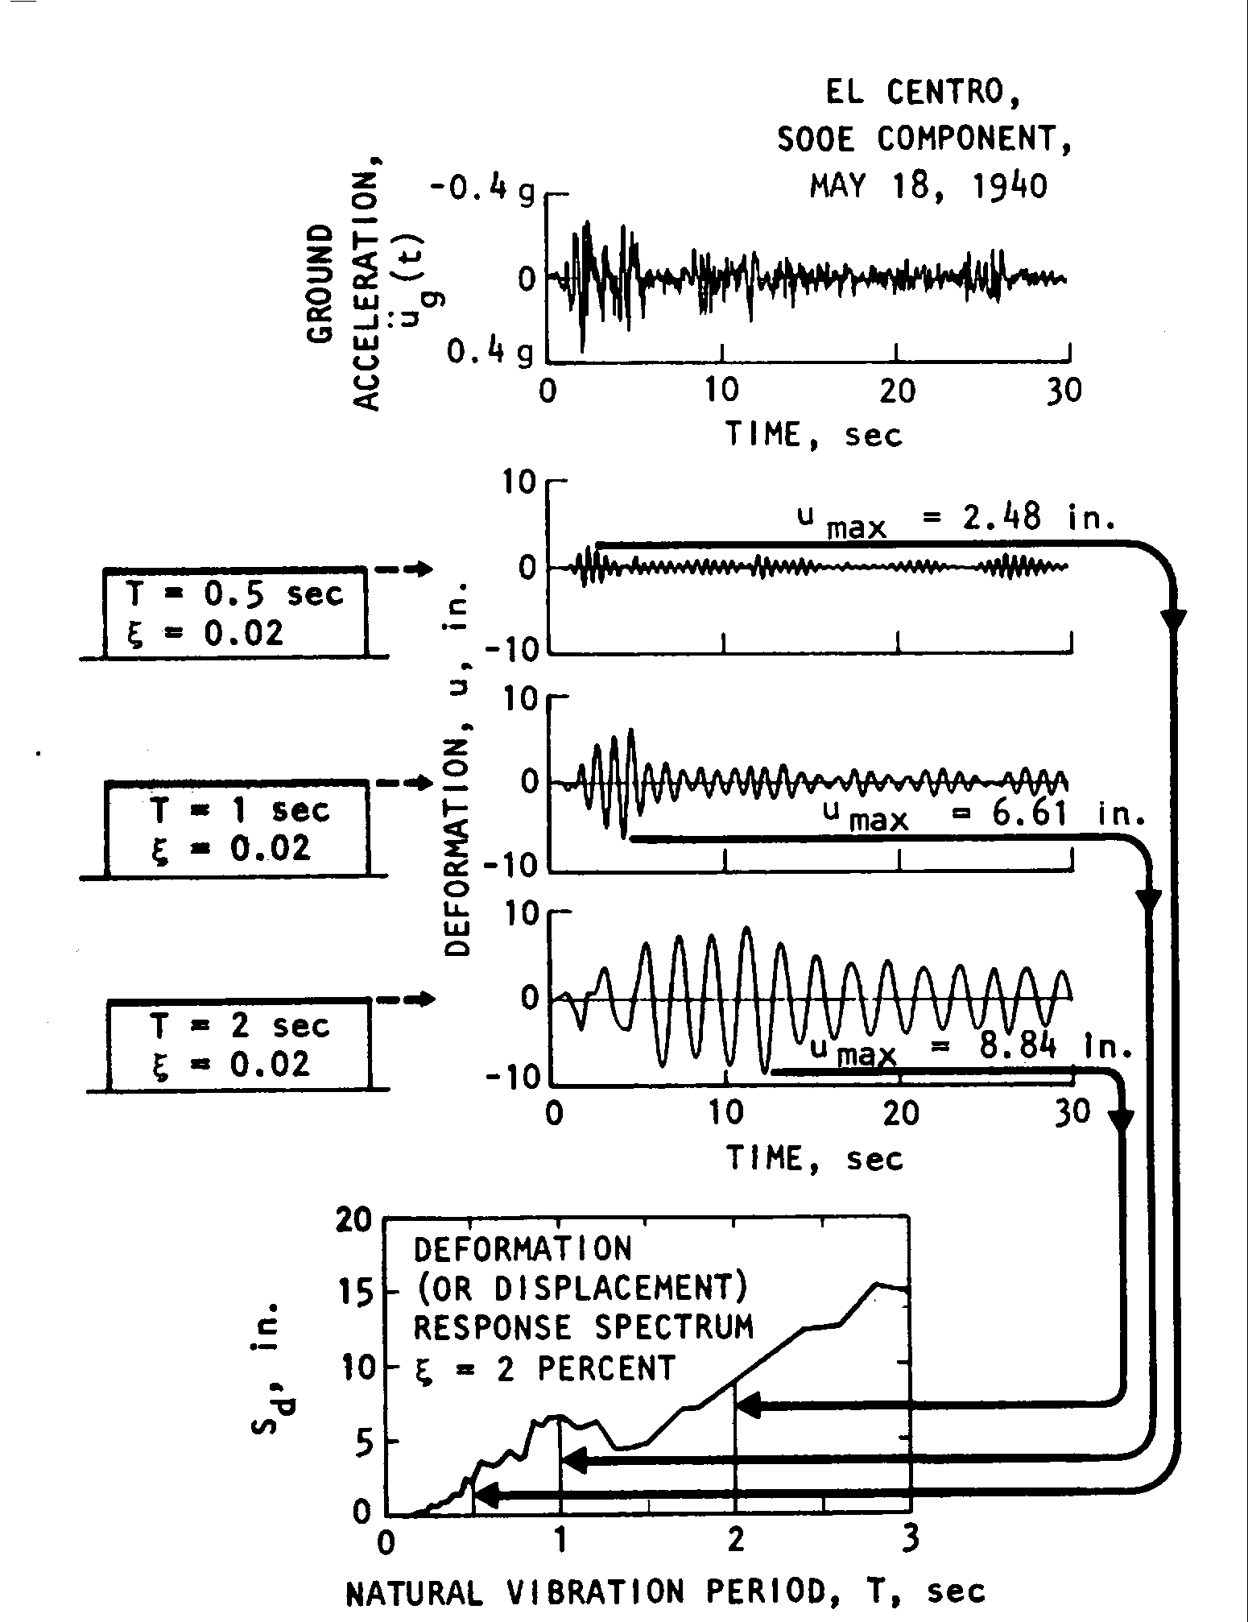
Response
Spectra

Slide 9
Four-Way Log Plot of Response Spectrum - PSV vs. PSA
Plotted vs Period
Displacement, in.
Acceleration, g
10.0
10.0
1.0
1.0
0.1
0.10
0.01
0.01
0.001
0.001

Slide 10
NEHRP-94
The ratio (for a 5% damping spectrum) of the spectral response at the appropriate period to EPA or the EPV is set at a standard value of 2.5 in both cases.
According to NEHRP 94, the effective peak acceleration (A_{a}) may be determined by dividing map values of the maximum 0.3 second (3 Hz) spectral response acceleration by 2.5.

Slide 11
SBC Table 1607.3.1 Site Coefficients
Soil Profile Type | Description | Site Coefficient S
S₁ | A soil profile with either: Rock of any characteristics, either shake-like or crystalline in nature, which has a shear wave velocity of greater than 2,500 ft/sec or stiff soil conditions where the soil depth is less than 200 ft and the soil types overlaying rock are stable deposits of sands, gravels or stiff clays | 1.0
S₂ | A soil profile with deep cohesionless or stiff clay conditions, where the soil depth exceeds 200 ft and soil types overlaying rock are stable deposits of sands, gravels, or stiff clay. | 1.2
S₃ | A soil profile containing 20 to 40 ft in thickness of soft to medium stiff clays with or without intervening layers of cohesionless soils. | 1.5
S₄ | A soil profile characterized by a shear wave velocity of less than 500 feet per second containing more than 40 ft of soft clay. | 2.0

Slide 12
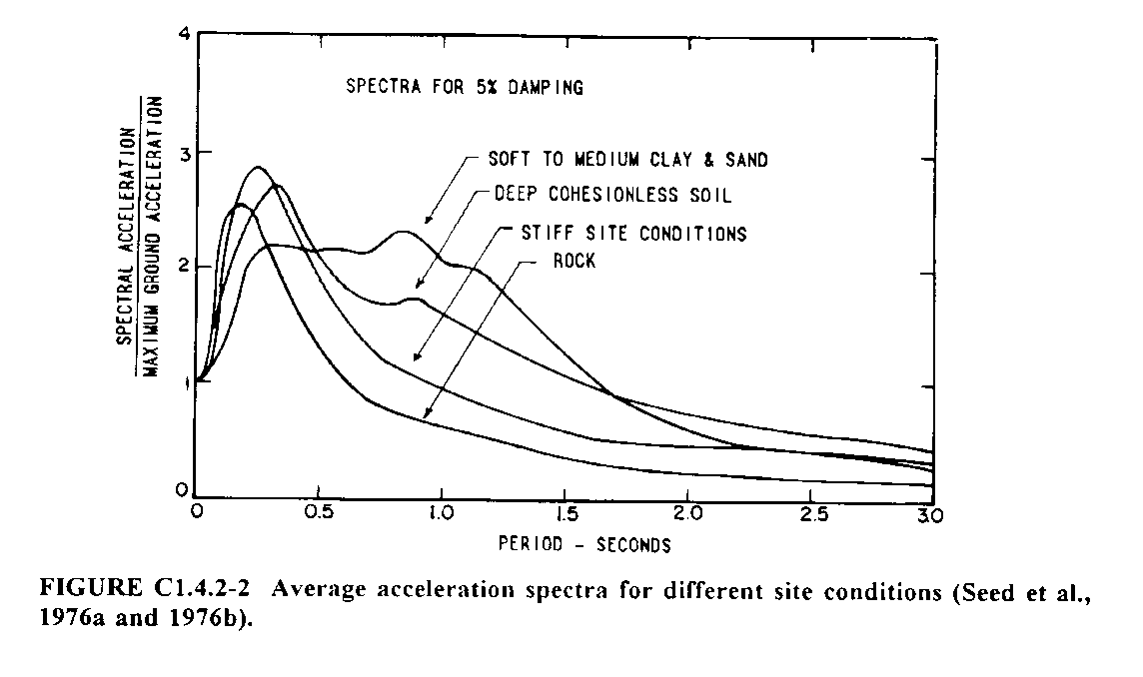
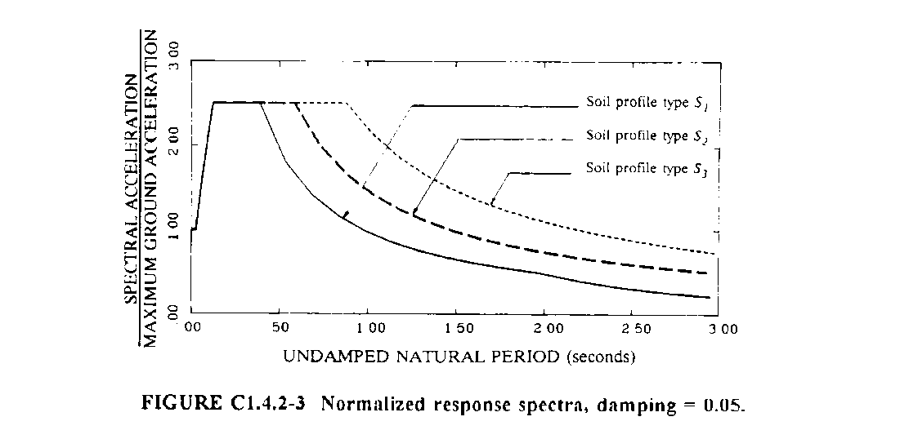
Acceleration Spectra for Different Site Conditions

Slide 13
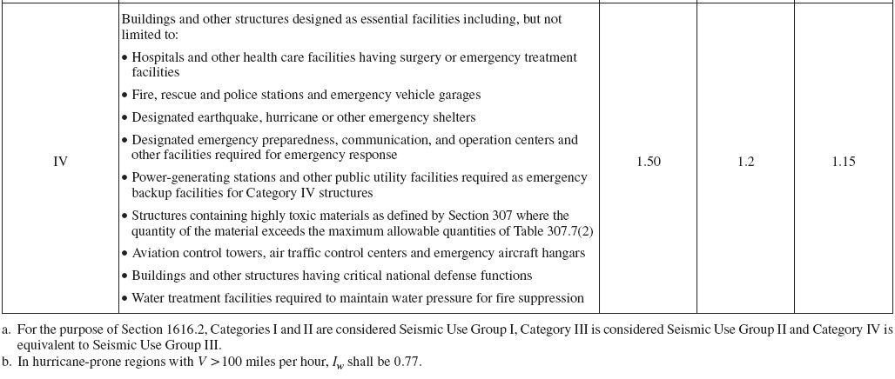
IBC
Classification of Buildings

Slide 14
IBC2003 and NEHRP97
Maximum Considered Earthquake Ground Motion
It is intended to provide a uniform margin against collapse at the design ground motion.
Ground motion hazards are defined in terms of maximum considered earthquake ground motions.
The maximum considered earthquake ground motions are based on a set of rules that depend on the seismicity of an individual region.

Slide 15
2% in 50 Years? 10% in 50 Years
3% in 75 Years?
2% probability of exceedance in 50 years
3% probability of exceedance in 75 years
10% probability of exceedance in 50 years

Slide 16
Design Spectral Response Accelerations
Maps, S_{s} and S₁
S_{s} is the mapped value, from Map 1 of 5% damped maximum considered earthquake spectral response acceleration, for short period structures founded on Class B, firm rock, sites.
The short period acceleration has been determined at a period of 0.2 seconds.

Slide 17
Design Spectral Response Accelerations
Maps, S_{s} and S₁
S₁ is the mapped value, from Map 2 of 5% damped maximum considered earthquake spectral response acceleration at a period of 1 second on site Class B.
The spectral response acceleration at periods other than 1 second can typically be derived from the acceleration at 1 second.

Slide 19
Modified IBC2003

Slide 20
Site Coefficients, F_{a} and F_{v}
Soil Profile Type
S_{MS} = The maximum Considered Spectral Response
Acceleration for short period
S_{M1} = The maximum Considered Spectral Response
Acceleration for 1 second period

Slide 21
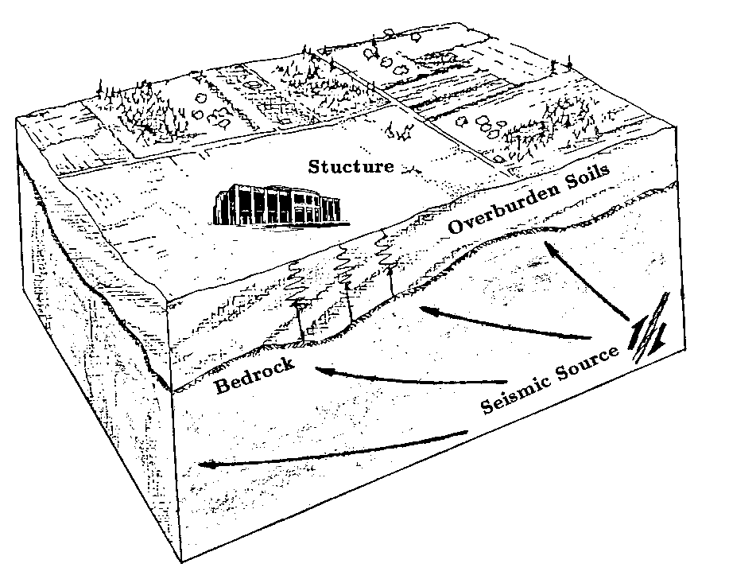
Soil Profile
Type and depth of softer soil layers between rock and firm ground and base of building can affect spectral accelerations in two ways
  By amplifying rock or firm ground acceleration
    most significant for low rock or firm ground accelerations and very soft soil layers.
  By filtering rock or firm ground accelerations
    softer soil layers act as filter
    Change of frequency content.

Slide 22
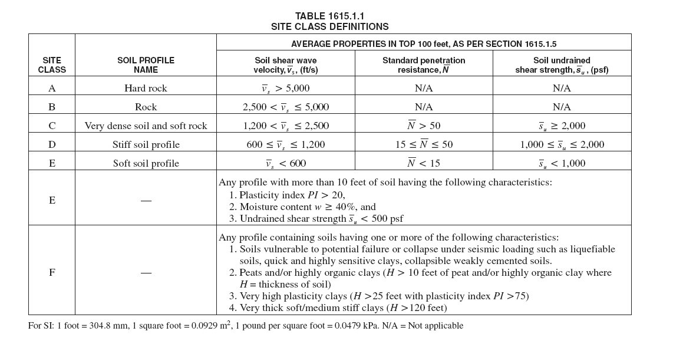
Site Class

Slide 23
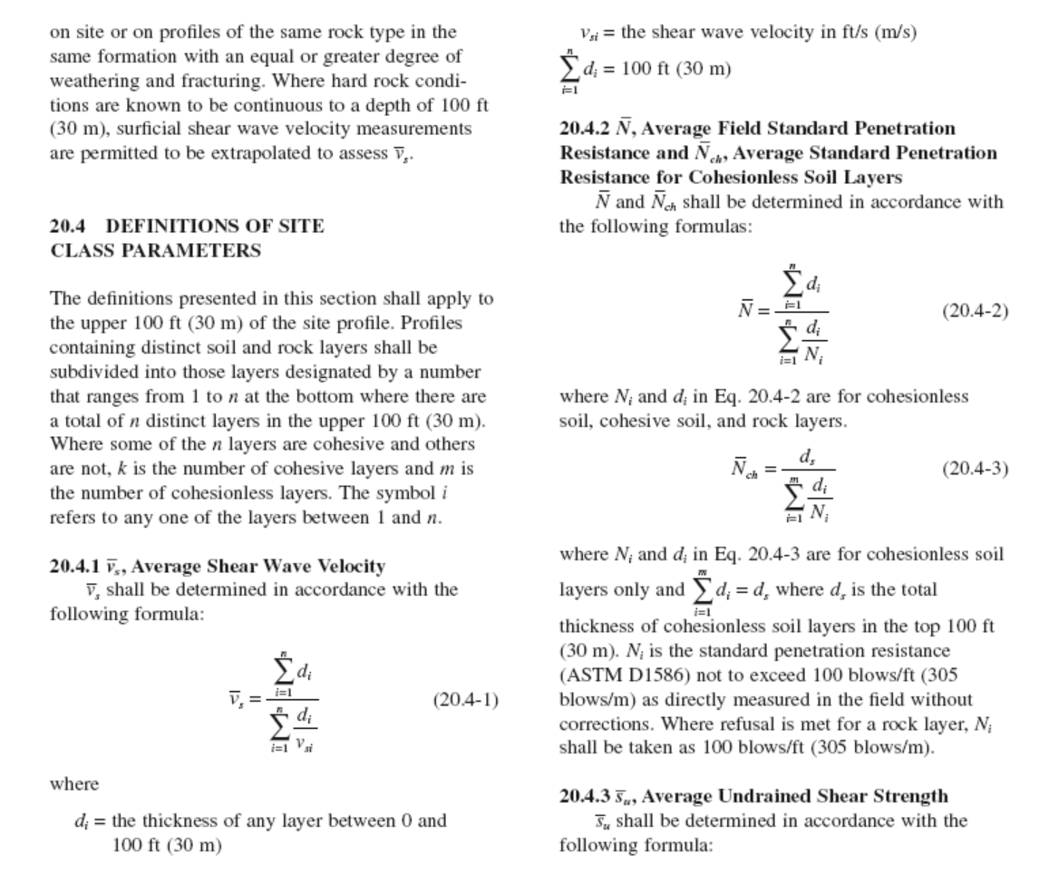
Average Shear-Wave Velocity and Average Blow Count

Slide 24
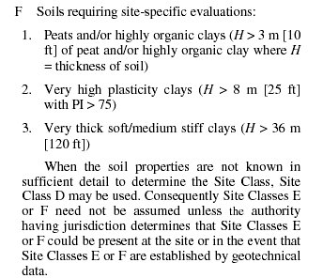
When to do Site Specific

Slide 25
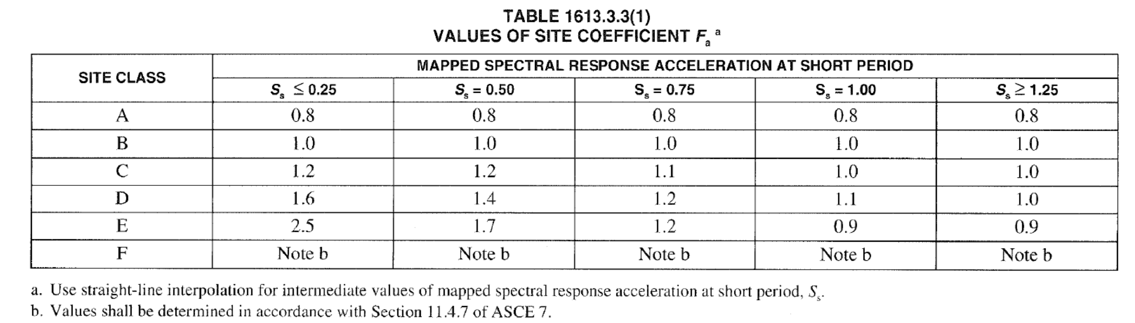
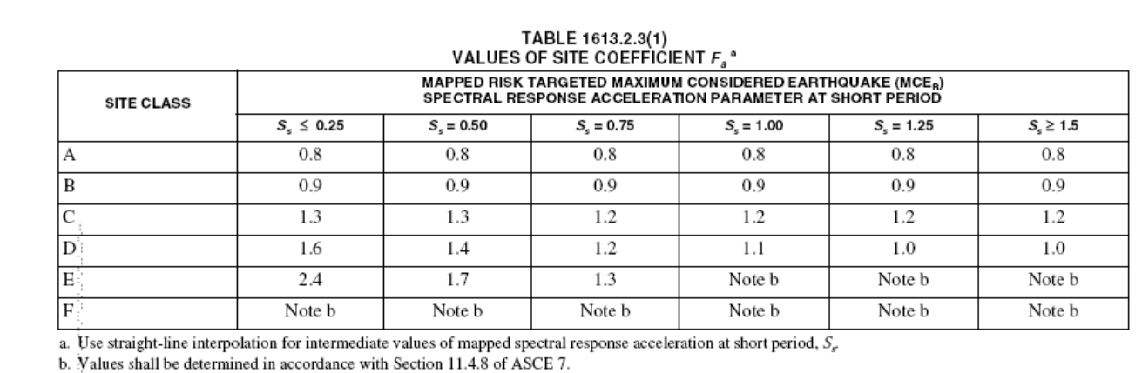
F_{a} as a Function of Site Class
IBC2012
IBC2018

Slide 26
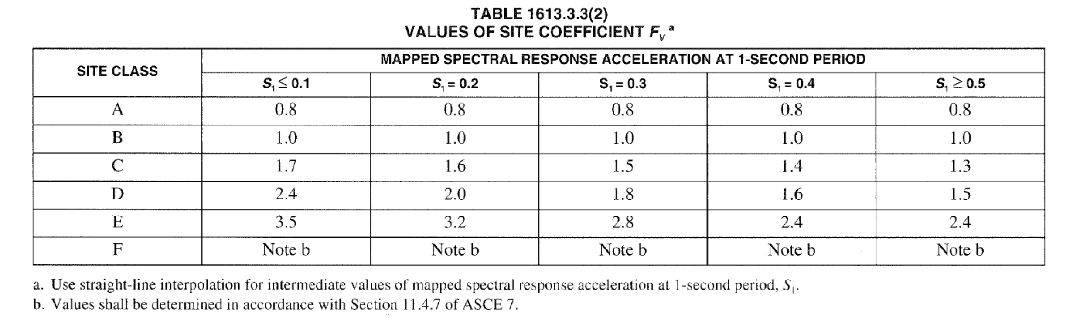
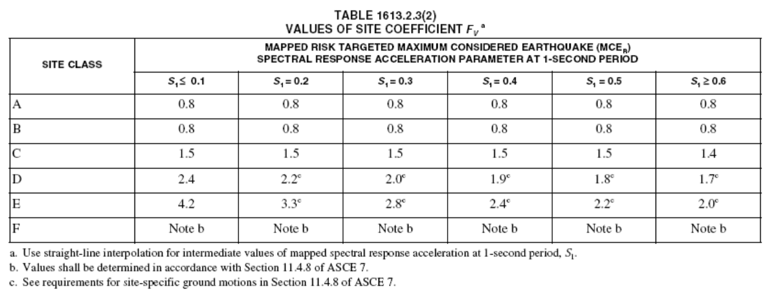
F_{v} as a Function of Site Class
IBC2012
IBC2018

Slide 27
Design Earthquake Ground Motion
The design
earthquake
ground motion
is selected
Maximum
considered
earthquake
ground motion
=
For most regions, the maximum considered earthquake ground motion is defined with a uniform likelihood of exceedance of 2% in 50 years (return period of about 2500 years)

Slide 28
Design Spectral Response Acceleration Parameters, S_{DS} and S_{D1}

Slide 29
Design Response Spectrum
S_{DS}
S_{DS}
S_{a}=S_{D1}/T
S_{D1}
Spectral Response Acceleration S_{a}
T₀
T_{S}
1.0
Period T
T₀=0.2S_{D1}/S_{DS}
T_{S} =S_{D1}/S_{DS}

Slide 30
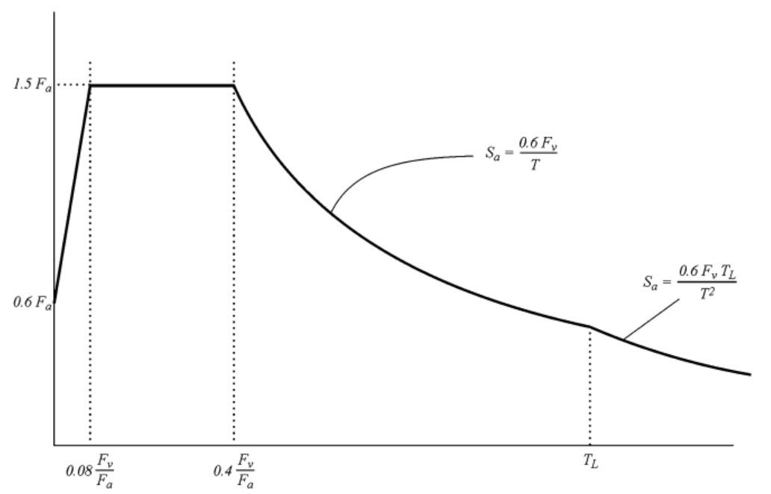
Design Response Spectrum

Slide 31
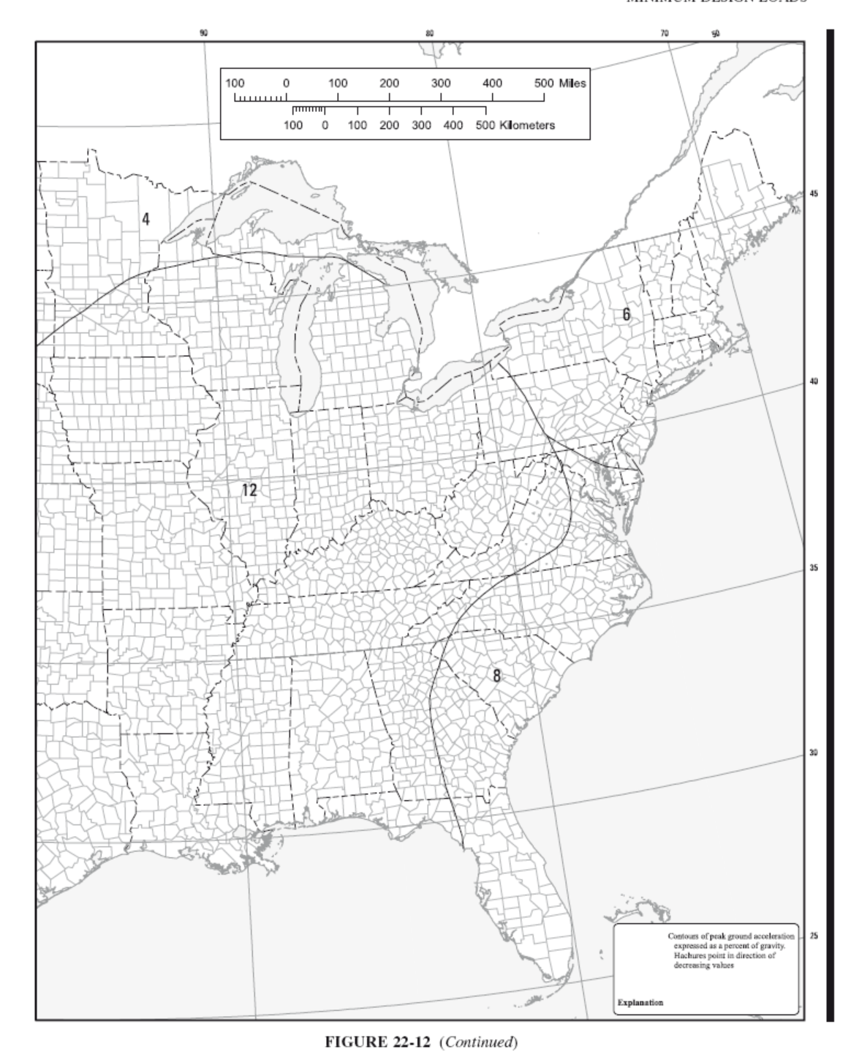
T_{L}

Slide 32
Seismic Response Coefficient
Need not to exceed the following
Shall not be taken less than
Seismic Design Category E and F for which S₁ is equal to or
Greater than 0.6g, the value C_{s} shall not be taken less than:

Slide 33
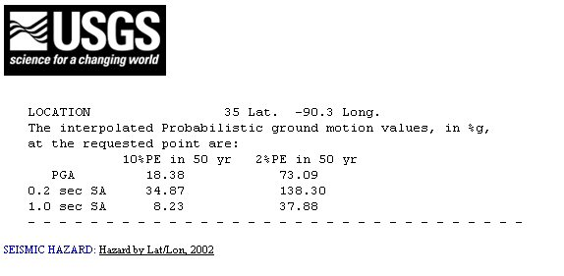
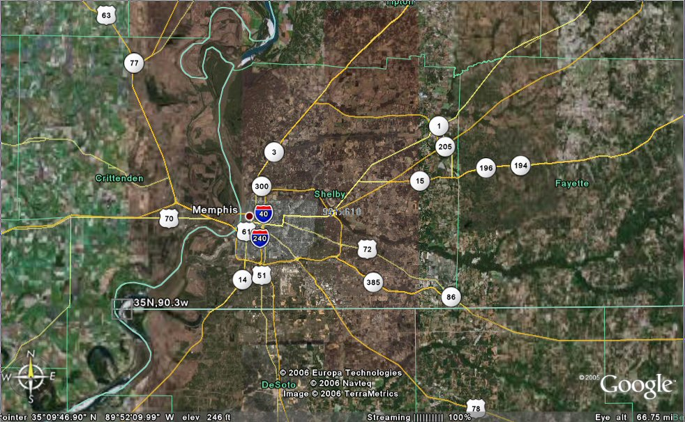
Study Site

Slide 34
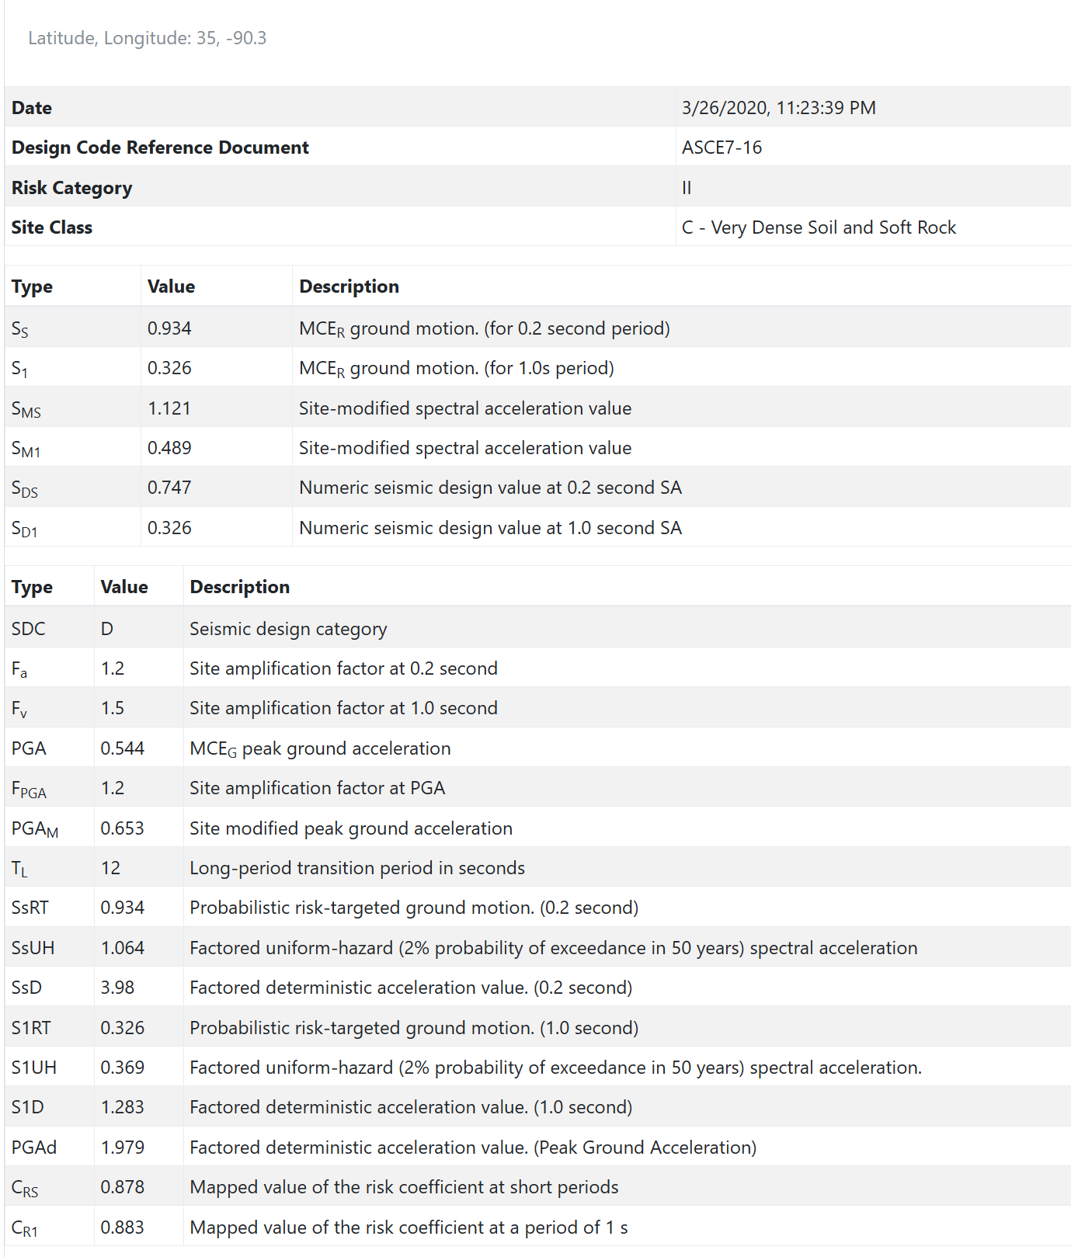
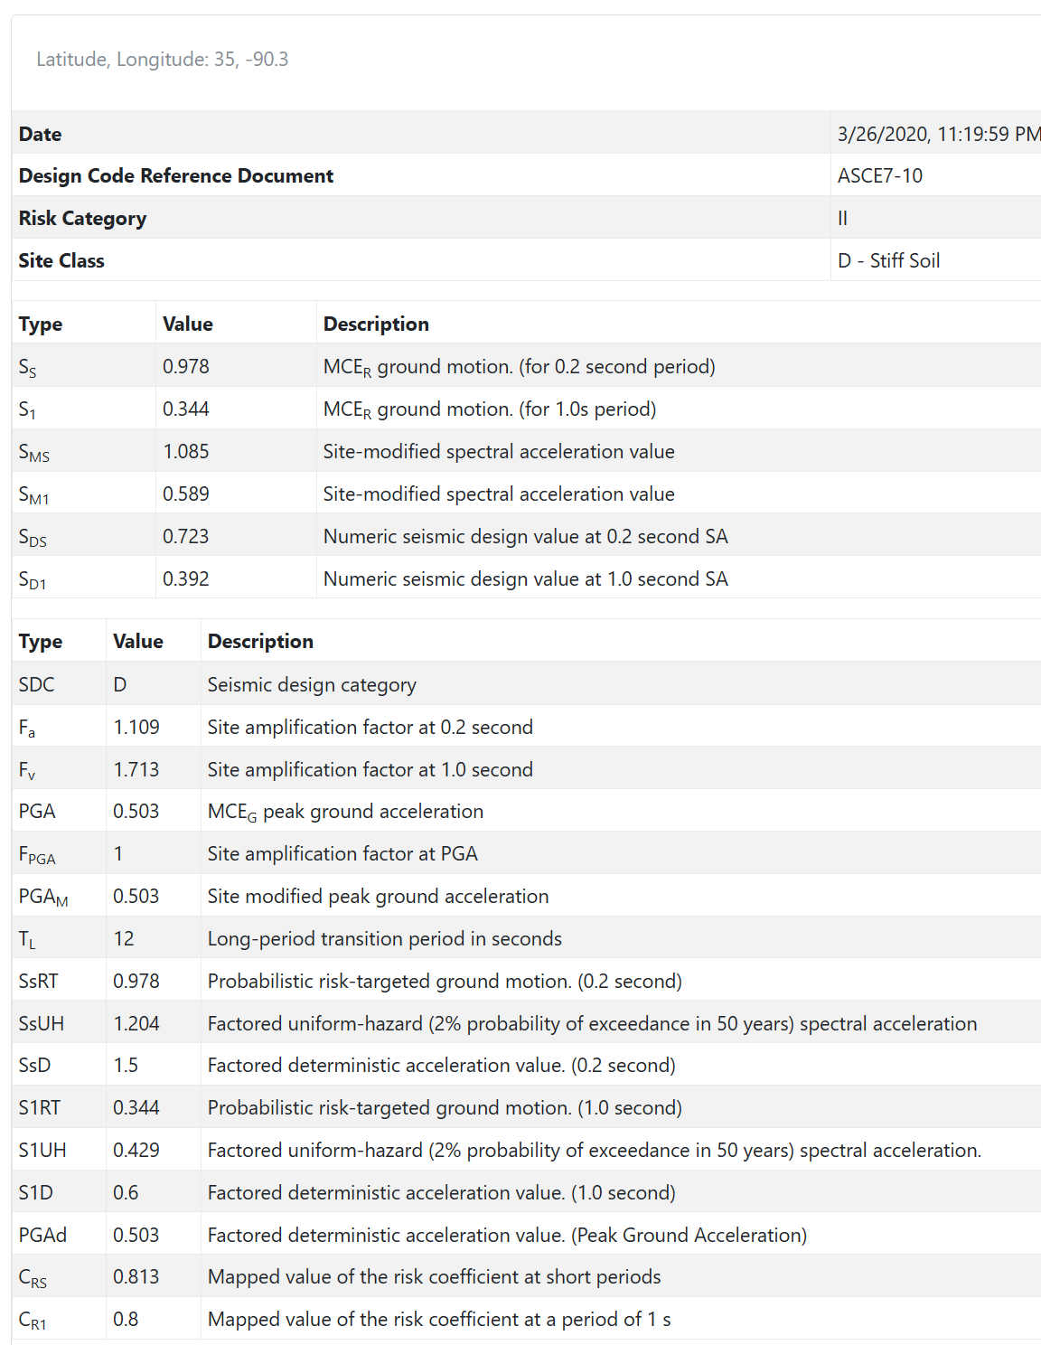
https://seismicmaps.org/
ASCE 7-16
ASCE 7-10

Slide 35
Response Spectra

Slide 36
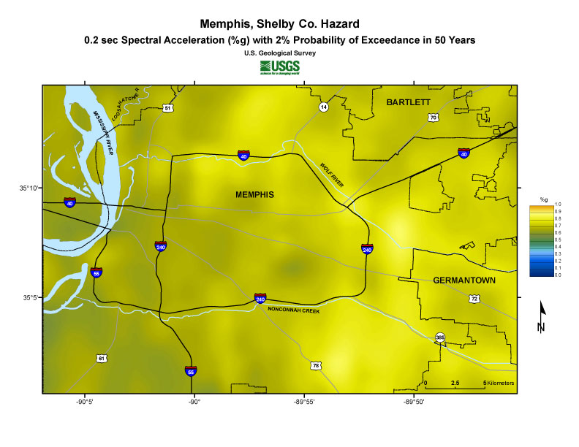
http://earthquake.usgs.gov/regional/ceus/products/grid_download.php#Probabilistic?page=products/grid_download.html&toc=products/products_toc.htm
0.6g

Slide 37
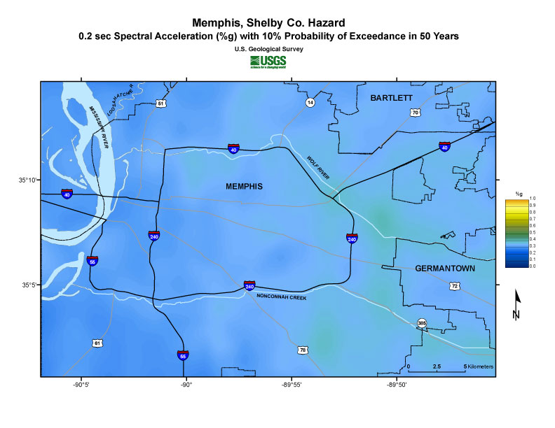
0.3g

Slide 38
When to Perform Site Specific Analyses
Perform site-specific studies when we have evidence that uncertainties associated with site-specific analyses can be reduced by going to the effort and cost to conduct such analyses.

Slide 39
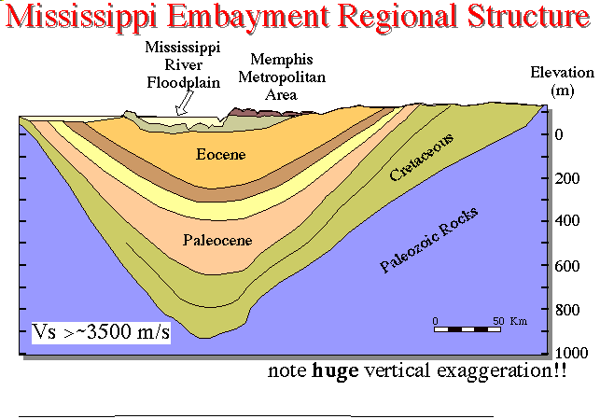
Local Site Effect

Slide 40



One-Dimensional Ground Response Analysis
Shallow Soil Layers
Near Site:
A_{m}(f) P(f,f_{m})
Propagation Path
G(R) D(R,f)
Seismic Source:
M₀S(f)
Crustal Rock

Slide 41
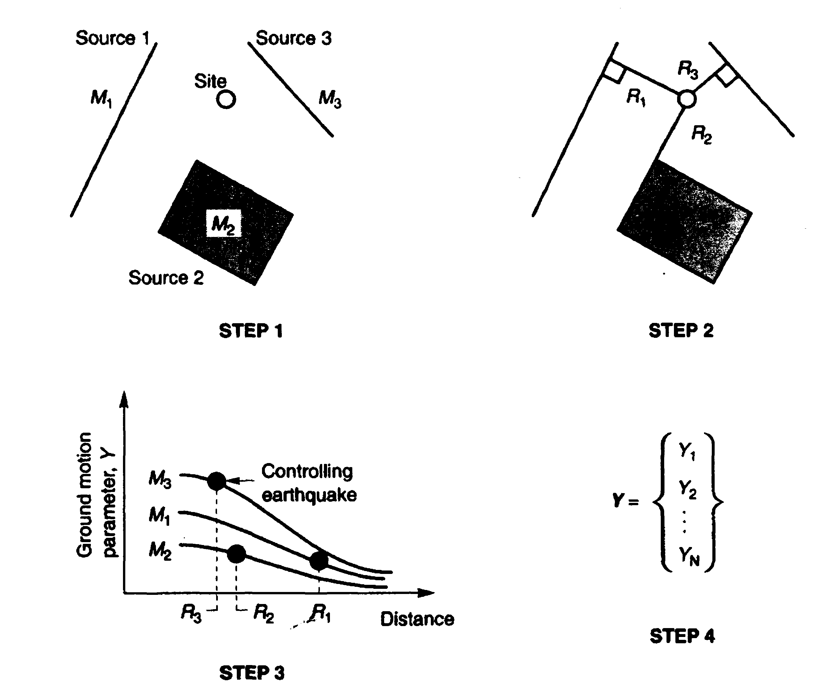
Deterministic Seismic Hazard Analysis (DSHA)
M₂
M₂
Notes:
Identify and characterize all earthquake sources capable of generating significant shaking at the site.
Calculate the source-to-site distance for each source identified in step 1.
Distance measures can include epicentral distance and hypocentral distance: depending on the distance measure adopted in the predictive (attenuation) relationship.
Step 2 in the figure below illustrates the calculation.
Select the controlling earthquake, that is, the earthquake that generates the greatest shaking effect (typically acceleration) at the site using attenuation relationships.
Step 3 of the figure illustrates the process for the three sources and distances. The controlling earthquake is described in terms of its magnitude and distance from the site (e.g., 7 at 10 km).
Define the hazard at the site by the controlling earthquake (spectral ordinates, maximum ground acceleration, maximum ground velocity, maximum ground displacement).

Slide 42
Probabilistic Seismic Hazard Analysis (cont’d)
f(M)
Define Seismicity
Parameters
Define Ground Motion
Attenuation
Area Source
Y
Fault
M_{o}
M_{u}
M
Identify Seismic Sources
Distance
Develop Seismic
Hazard Curve
Historical Seismicity
Identify Geological Structures
and Tectonic Features
P_{o}
Annual Probability
of Exceedance
Y₀
Y

Slide 43
Logic Tree
Source
Geometry
Maximum
Magnitude
Seismicity
Model
Attenuation
Equation

Slide 44
Site Response Analysis (cont’d)
Depth
Collected Shallow
Soil boring
Database
Soil Profile for Upper
Part 200 feet to
Surface
0
200 ft
Deep Soil Profile for 200 feet to Paleozoic Rock
Field and
Laboratory
Investigations
Digitized Maps
and GIS Program
Notes:
We need to propagate time histories at the bedrock through rock and soil layers to the surface.
Consultants to the project suggested that we use a depth of 200 ft as our reference instead of B-C boundary. In addition, the soil amplification factors can be used for shallow soil profile.
Tim Stark of UoM in his recent talk at St. Louis suggested that we use a reference “stiff soil.” similar to the work we have done here.
Two approaches can be used:
1. Using Shake91 propagate time histories from hard rock (2000ft below ground surface) to the surface or 200 ft. or Develop rock outcrop time history using the Quaterwave length amplification approach. Find the time history
at the base of the soil layers and use shake for the top 700 or 600 ft.
For shallow soil profile use collected soil boring logs and downhole and resonant column testing. Use the mapped GIS database of soil layers to the desired rock site location.

Slide 45
Structural Contour Map, Van Arsdale (2001)
Increasing Deposit Thickness (m)

Slide 46
Near-Surface V_{s} Profiles
Romero and Rix (2001)
and Romero (2001)

Slide 47
Reference V_{s} Profiles (Rix,2001)

Slide 48
Example

Slide 49
Example Results

Slide 50
Example Results

Slide 51
Example Results

Slide 52
Example Results

Slide 53
Example Results

Slide 54
Somerville

Slide 55
Paris

Slide 56
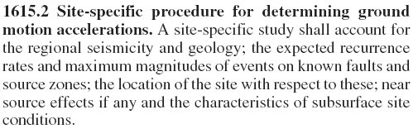
Site Specific

Slide 57
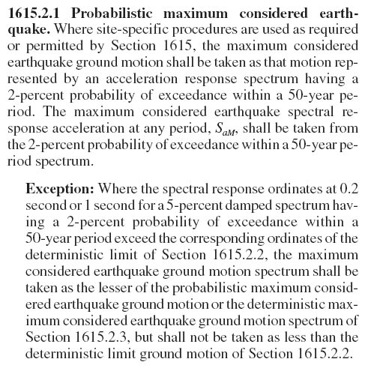
Probabilistic Maximum Considered Earthquake

Slide 58
Probabilistic Maximum Considered Earthquake

Slide 59
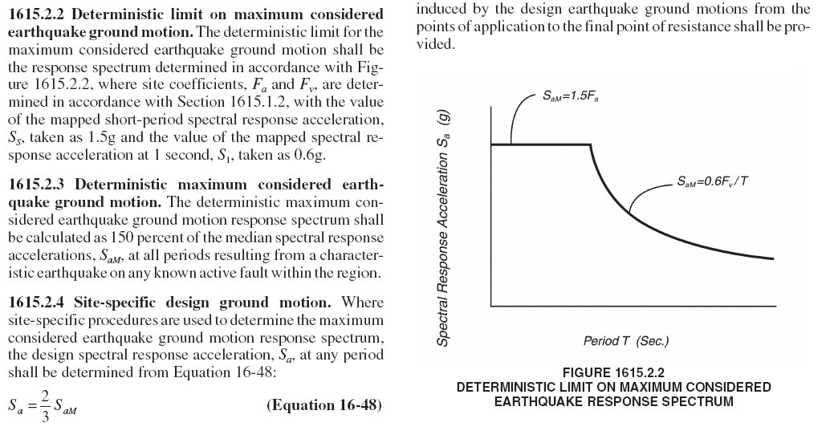
Deterministic Limit

Slide 60
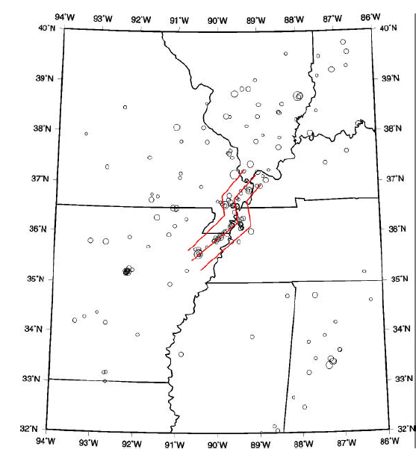
Characteristic Sources: Fictitious faults of NMSZ, M=8.0

Slide 61
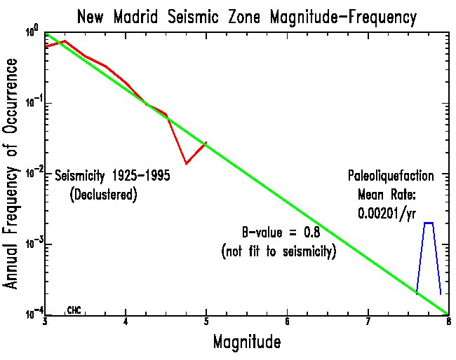
Annual Frequency of Occurrence

Slide 62
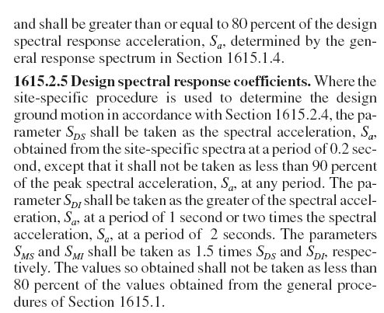
Reduction Limitation

Slide 63
Design Spectral Response Coefficients

Slide 64
Response Spectra Based on Site Specific Procedures Sect 3.4.3
A site-specific probabilistic ground motion analysis shall include the following:
  Characterization of seismic sources and ground motion attenuation that incorporates current scientific interpretations, including uncertainties in seismic source and ground motion models and parameter values
  Detailed documentation
  Detailed peer review

Slide 65
Site Class F
Where analyses to determine site soil response effects are required for Site Class F soils, the influence of the local soil conditions shall be determined based on site-specific geotechnical investigation and dynamic site response analyses.

Slide 66
Response Spectra Based on Site Specific Procedures Sect 3.4.3
For sites located within 10 km of an active fault, studies shall be considered to quantify near-fault effects on ground motions if these could significantly influence the bridge response.

Slide 67
Response Spectra Based on Site Specific Procedures Sect 3.4.3
In cases where the 0.2 second or 1.0 second response spectral accelerations of the site-specific exceeds the response spectrum shown below, a deterministic spectrum may be utilized in regions having known active faults if the deterministic spectrum is lower than the probabilistic spectrum.
Spectral Response Acceleration S_{a}
Period T

Slide 68
Response Spectra Based on Site Specific Procedures Sect 3.4.3
The deterministic spectrum shall be the envelope of the median-plus standard deviation spectra calculated for characteristic maximum magnitude earthquakes on know active faults, but shall not be lower that the spectrum shown below.
Spectral Response Acceleration S_{a}
Period T

Slide 69
Response Spectra Based on Site Specific Procedures Sect 3.4.3
If there is more than one active fault in the site region, the deterministic spectrum shall be calculated as the envelope of spectra for the different faults.
Alternatively, deterministic spectra may be defined for each fault and each spectrum, or the spectrum that governs bridge response may be used for the analysis of the bridge.
When response spectra are determined from a site-specific study, the spectra shall not be lower than two-third of the response spectra determined using the code procedure.

Slide 70
Acceleration Time Histories Sect. 3.4.4
Time histories shall be either recorded time histories or spectrum-matched time histories.
If sufficient recorded motions are not available, simulated-recorded time histories may be developed using theoretical ground motion modeling methods that simulate the earthquake rupture and the source-to-site seismic wave propagation.
If spectrum matched time histories are developed, the initial time histories to be spectrum matched shall be representative recorded or simulated-recorded motions.
Analytical techniques used for spectrum matching shall be demonstrated to be capable of achieving seismologically realistic time series that are similar to the time series of the initial time histories selected for spectrum matching.

Slide 71
Acceleration Time Histories Sect. 3.4.4
When using recorded or simulated time histories, they shall be scaled to the approximate level of the design response spectrum in the period range of significance.
For each component of motion, an aggregate match of the design response spectrum shall be achieved for the set of acceleration time histories used.
A mean spectrum of the individual spectra of the time histories shall be calculated period-by-period.
Over the defined period range of significance, the mean spectrum shall not be more than 15% lower than the design spectrum at any period and the average of ratio of the mean spectrum to the design spectrum shall be equal to or greater than unity.

Slide 72
Questions?

