Slide 1
Rate of Return

Slide 2
Rate of return is the rate paid on the unpaid balance of borrowed money
or the rate earned on the unrecovered balance of an investment so that the final payment or receipt brings the balance to exactly zero.

Slide 3
Rate of return is the rate paid on the unpaid balance of borrowed money
or the rate earned on the unrecovered balance of an investment so that the final payment or receipt brings the balance to exactly zero.

Slide 4
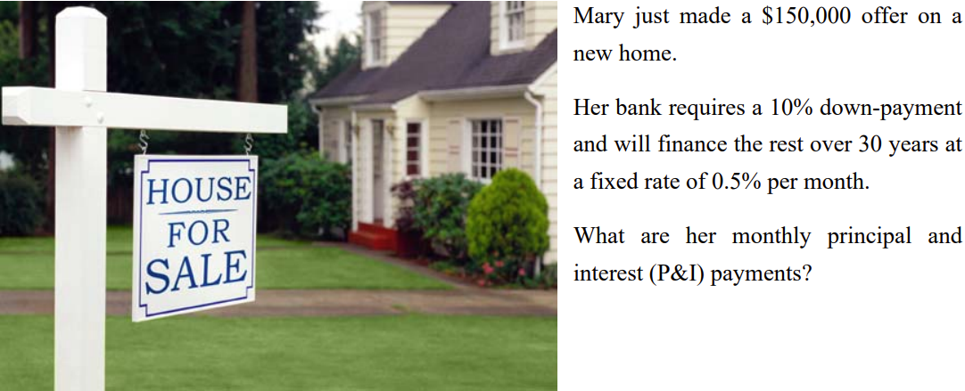

Slide 6
Rate of return is the interest rate that makes the cash inflows and cash outflows of a project economically equivalent to each other.

Slide 7
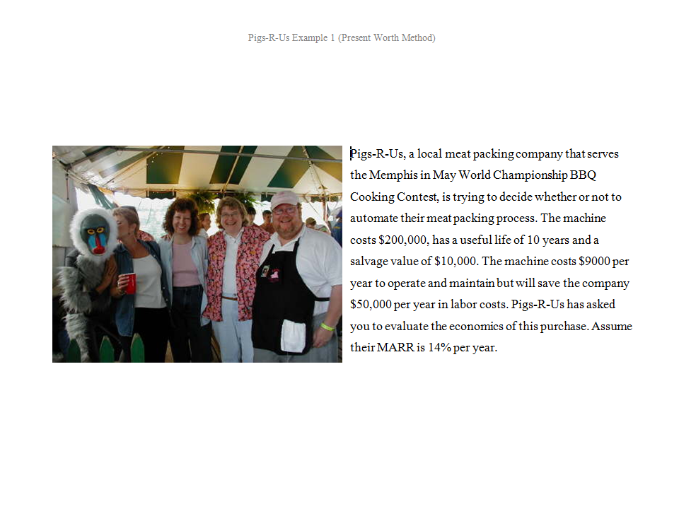

Slide 8
Rate of return is the interest rate
that makes the PW (or AW or FW)
of a project exactly equal to zero.

Slide 9
Rate of return is the rate paid on the unpaid balance of borrowed money or the rate earned on the unrecovered balance of an investment so that the final payment or receipt brings the balance to exactly zero.

Slide 10
Rate of return is the rate paid on the unpaid balance of borrowed money or the rate earned on the unrecovered balance of an investment so that the final payment or receipt brings the balance to exactly zero.

