Slide 1
Opportunity Cost Example
Assume that ACME, Inc. has $750,000 in available capital that it wants to use to grow the company and is considering the following investment possibilities:

Slide 2
Opportunity Cost Example
Assume that ACME, Inc. has $750,000 in available capital that it wants to use to grow the company and is considering the following investment possibilities:
Sort projects in order of decreasing rate of return

Slide 3
Opportunity Cost Example
Assume that ACME, Inc. has $750,000 in available capital that it wants to use to grow the company and is considering the following investment possibilities:
700
Determine which projects fit your capital budget

Slide 4
Opportunity Cost Example
Assume that ACME, Inc. has $750,000 in available capital that it wants to use to grow the company and is considering the following investment possibilities:
700
MARR
Best unfunded project determines your MARR

Slide 5
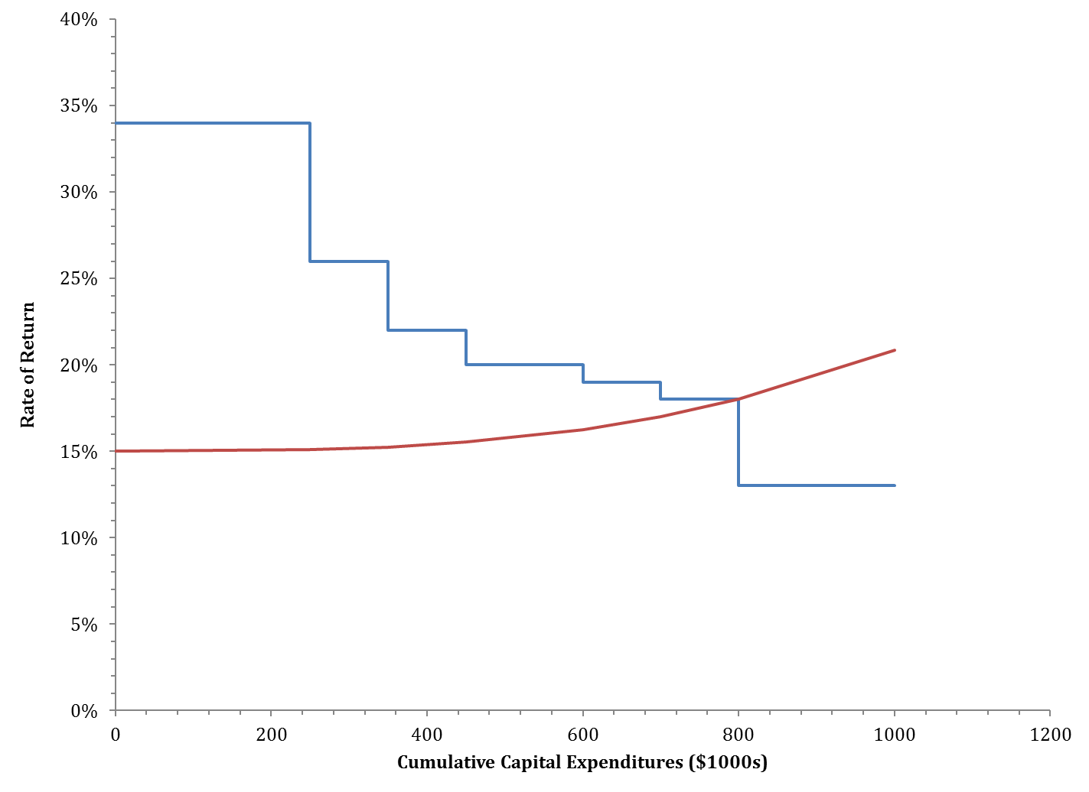
Opportunity Cost Example
Capital Budget
34% F
26% C
22% D
20% B
Cost of Capital
19% E
18% G
13% A

